Slide 1
Generic classes & methods

Slide 2
What is generic?
A class or method that doesn’t care what data type it is comprised of.
At compile time, the compiler will create every necessary class type for you.

Slide 3
Why did C# add generics?
In the past, developers would have to convert their data types into the “object” data type for insertion and storage, and would then cast back to their type upon retrieval for usage.
Generics in C# prevent this ugly situation and make it much easier to read and understand.

Slide 4
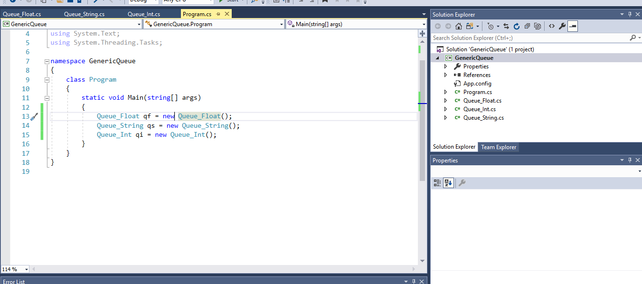
The wrong way

Slide 5
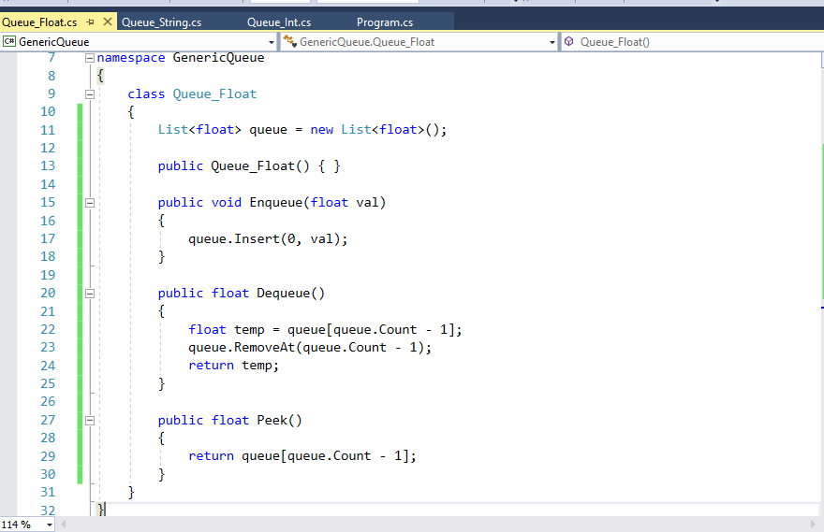
The wrong way

Slide 6
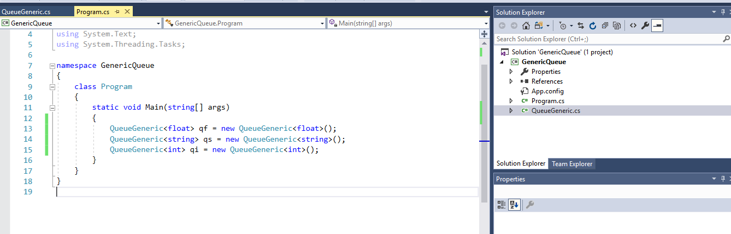
The right way

Slide 7
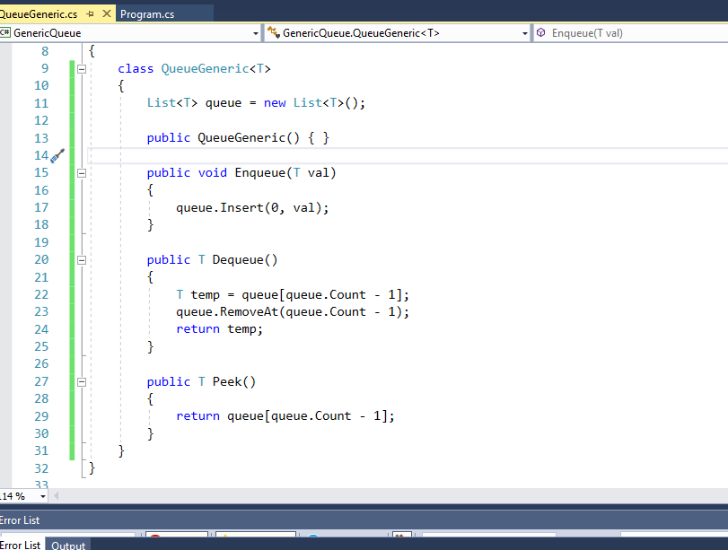
The right way

Slide 8
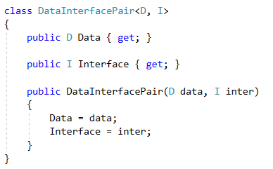
Generics with multiple types
Ties two data structures together in a meaningful way.

Slide 9
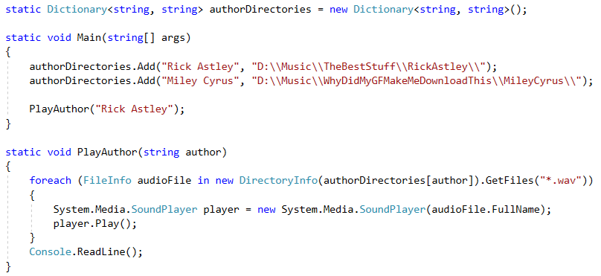
KeyValuePair<Key, Value>

Slide 10
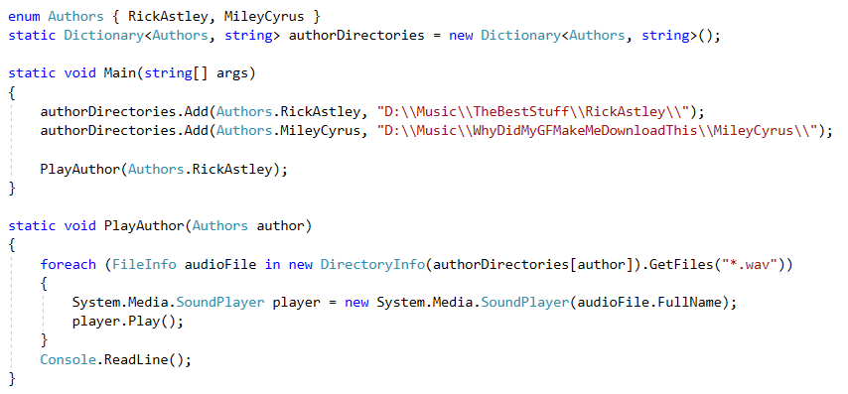
Using enums in Dictionaries

Slide 11
Example, AudioManager
https://github.com/darrare/Archive-12-2018/blob/master/Unity/AllUnityWork/Platformer/Platformer/Assets/Scripts/Managers/AudioManager.cs

Slide 12
Generic Methods
Instead of writing a method 50 times for 50 different data types, write it once!

Slide 13
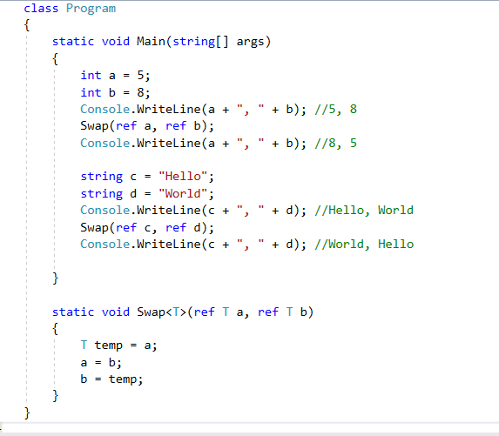

Slide 14
Interfaces
Similar to abstract classes.
Forces an object to implement certain behaviors.
Creates polymorphism among similar objects.
While you can only ever inherit from 1 class, you can inherit from unlimited interfaces.

Slide 15
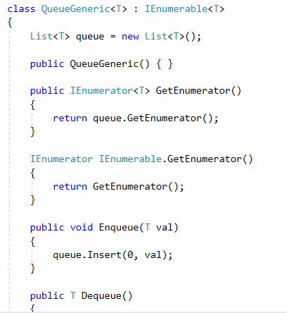
IEnumerable
Very common.
Forces your class to be enumerable
Enumerable means that it can be iterated through (like a list).

Slide 16
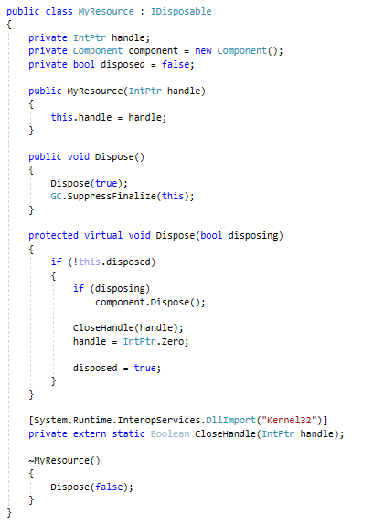
IDisposable
Implemented by StreamReader and StreamWriter.
Allows us to put our structure into a “using” statement.

Slide 17
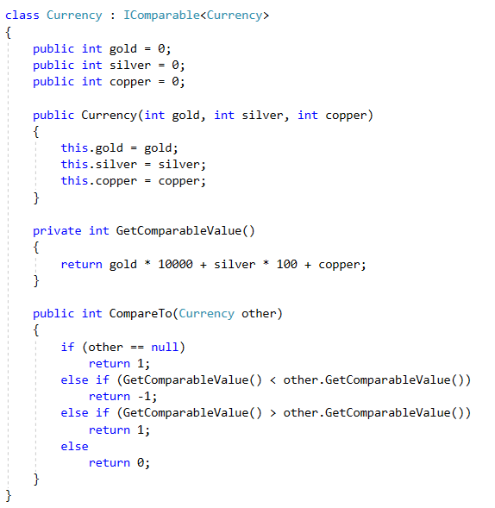
IComparable<T>
A generic interface that allows us to compare two of the same object

Slide 18
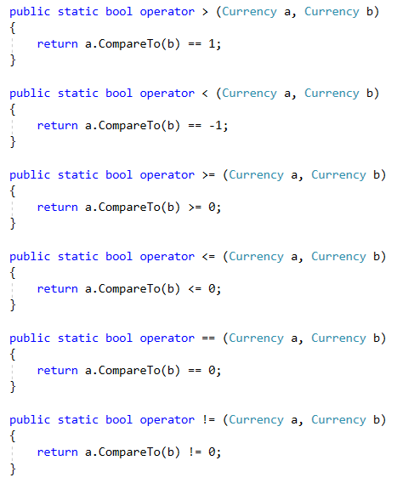
IComparable<T> extended
The ability to call .CompareTo() is nice and all, but the default operators will be much more easy to read and usable.

Slide 19
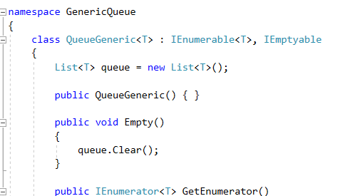
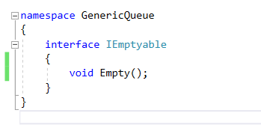
Custom Interfaces
Lets us dictate what we can and cannot do with our code.

Slide 20
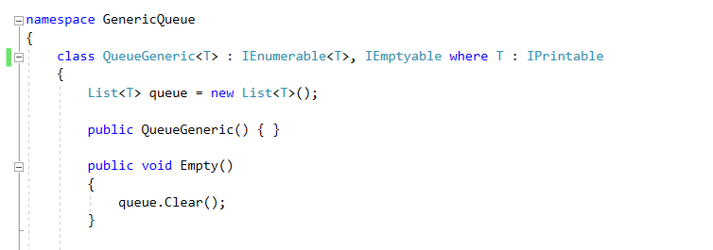
Requiring behaviors of T
Sometimes, you want to require that every generic class “T” that you handle has certain behaviors.
Perhaps we want every type of T to be easily printable.
So we require that every T inherits from IPrintable

Slide 21
Lab – Binary Tree
On Canvas, there is a project download that contains a simple binary tree that considers only integers.
Your goal is to modify it to do the following:
Accept any object type.
Remain a sorted binary tree (not balanced, just sorted)
Allow the developers to iterate through the tree with foreach

